Slide 1


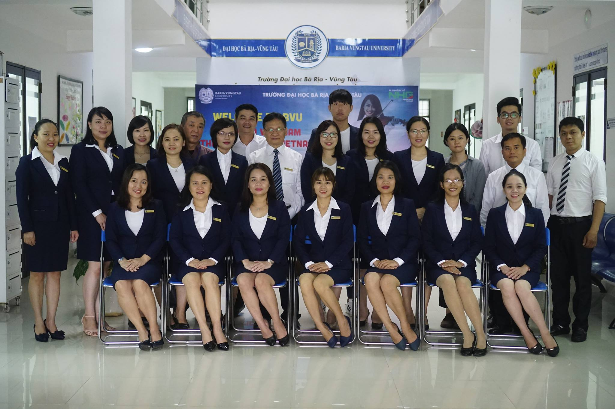

Slide 2

AMERICAN JETSTREAM PRE-INTERMEDIATE B

Slide 3
TEACHER’S PERSONAL INFORMATION
Name: Nguyen Thanh Loan
Facebook: Loan Nguyễn Thanh
Mobile number: 0942 255 937
Email: loannguyenthanh1978@gmail.com

Slide 4
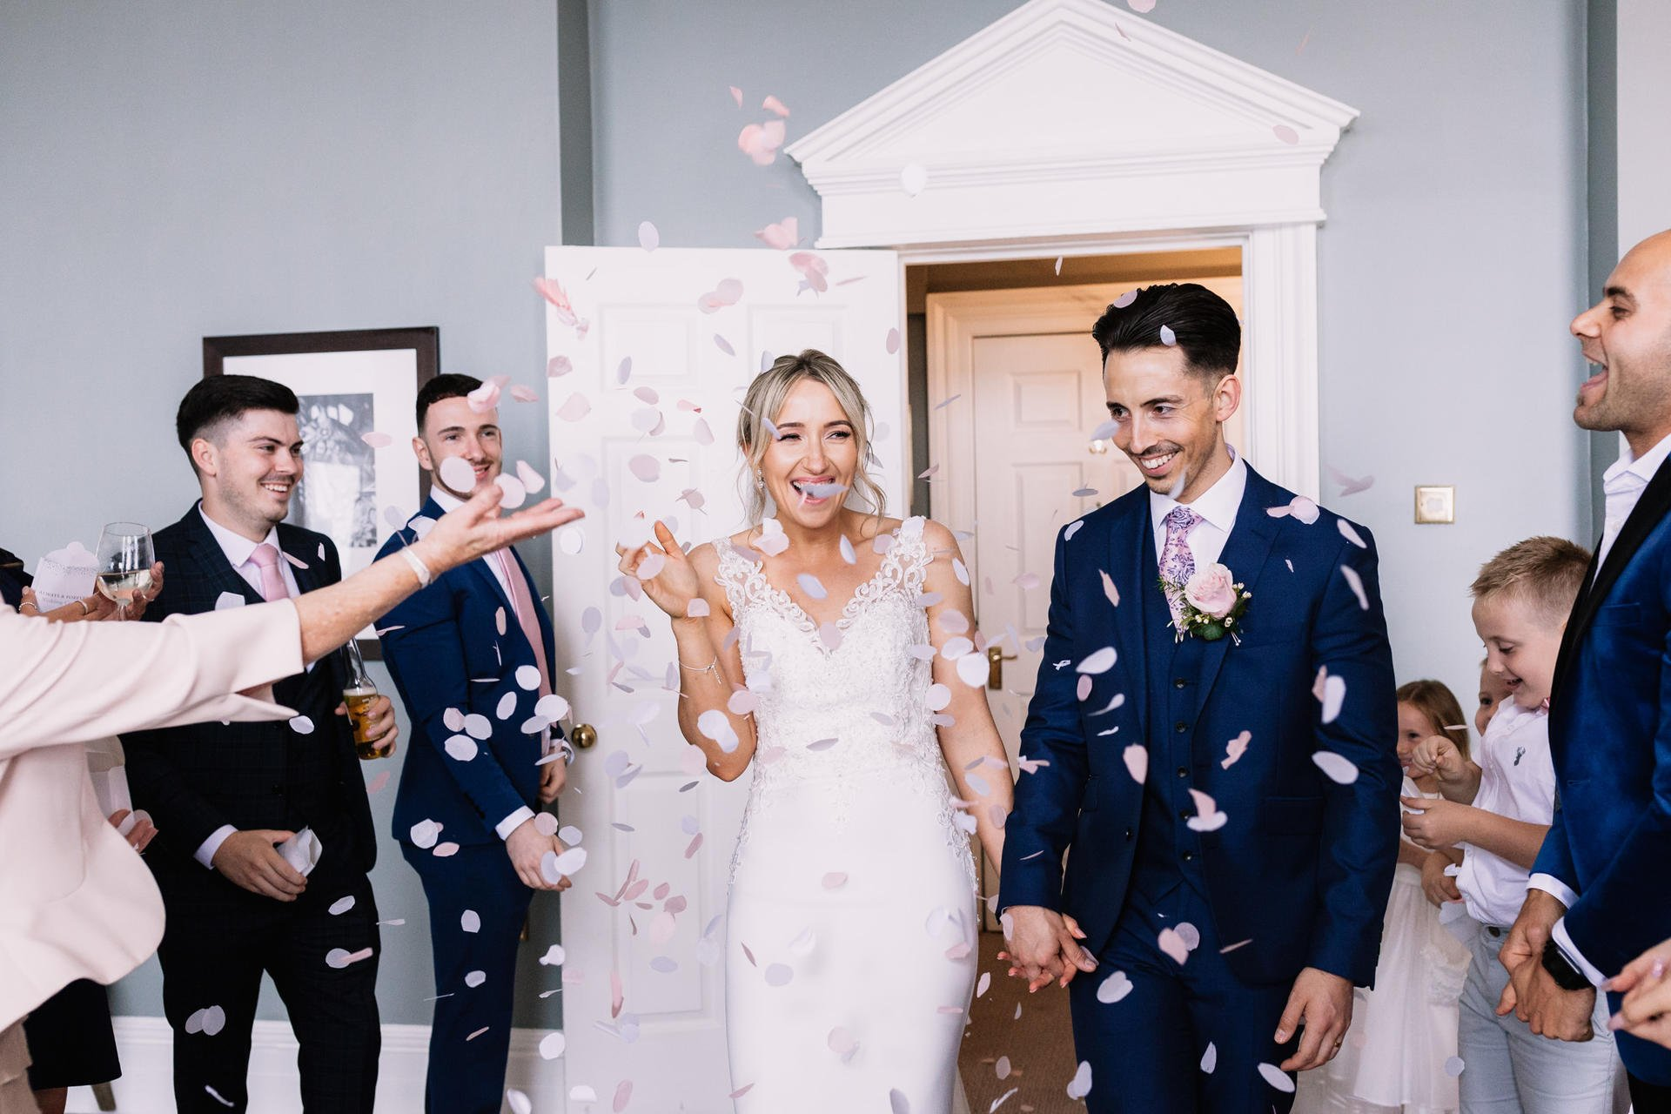
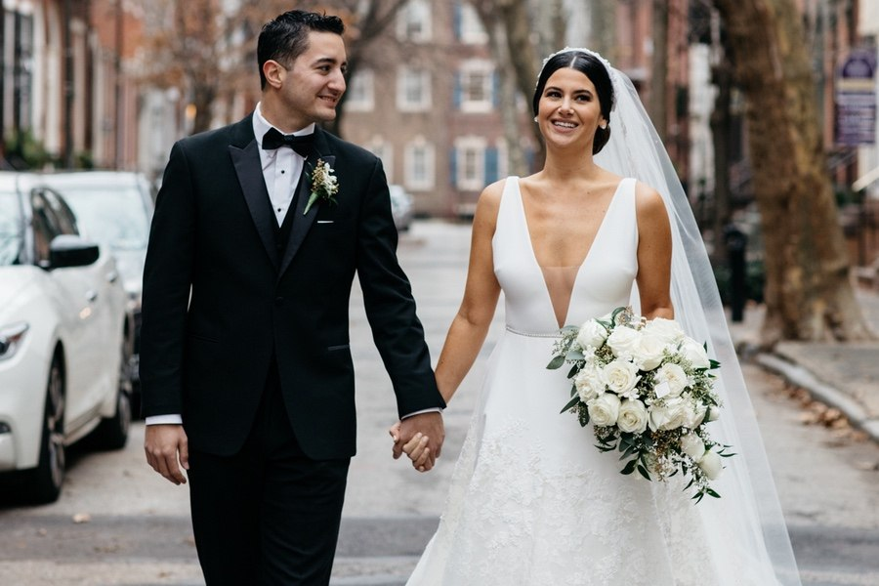
UNIT 12
SPECIAL OCCASIONS
/ˈspeʃl əˈkeɪʒn/
a particular time when something happens

Slide 5
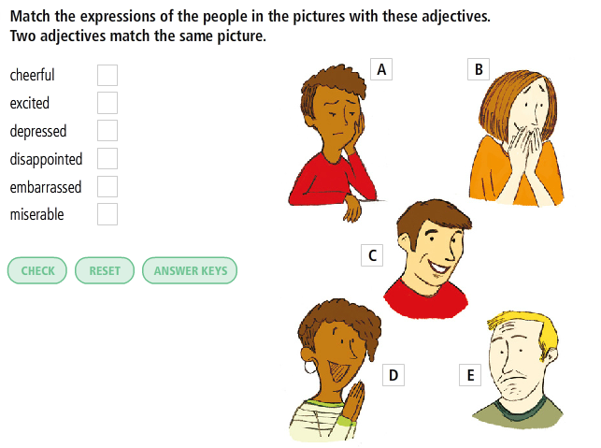
Vocabulary plus
Adjectives
describing feelings

Slide 6

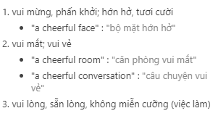
Vocabulary plus
Adjectives describing feelings
cheerful
/ˈtʃɪəfl/
happy, and showing it by the way that you behave

Slide 7

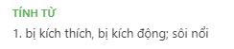
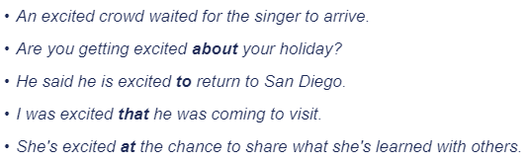
Vocabulary plus
Adjectives describing feelings
excited
/ɪkˈsaɪtɪd/
feeling or showing happiness and enthusiasm

Slide 8
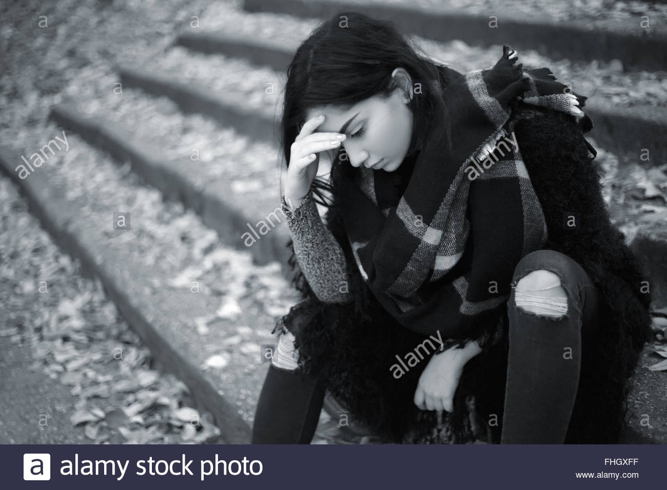
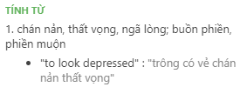
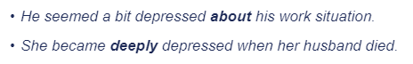
Vocabulary plus
Adjectives describing feelings
depressed
/dɪˈprest/
very sad and without hope

Slide 9
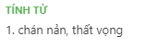

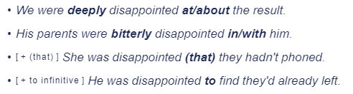
Vocabulary plus
Adjectives describing feelings
disappointed
/ˌdɪsəˈpɔɪntɪd/
upset because something you hoped for has not happened or been as good, successful, etc. as you expected

Slide 10

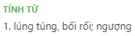
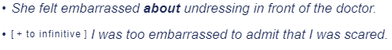
Vocabulary plus
Adjectives describing feelings
embarrassed
/ɪmˈbærəst/
shy, uncomfortable or ashamed, especially in a social situation

Slide 11
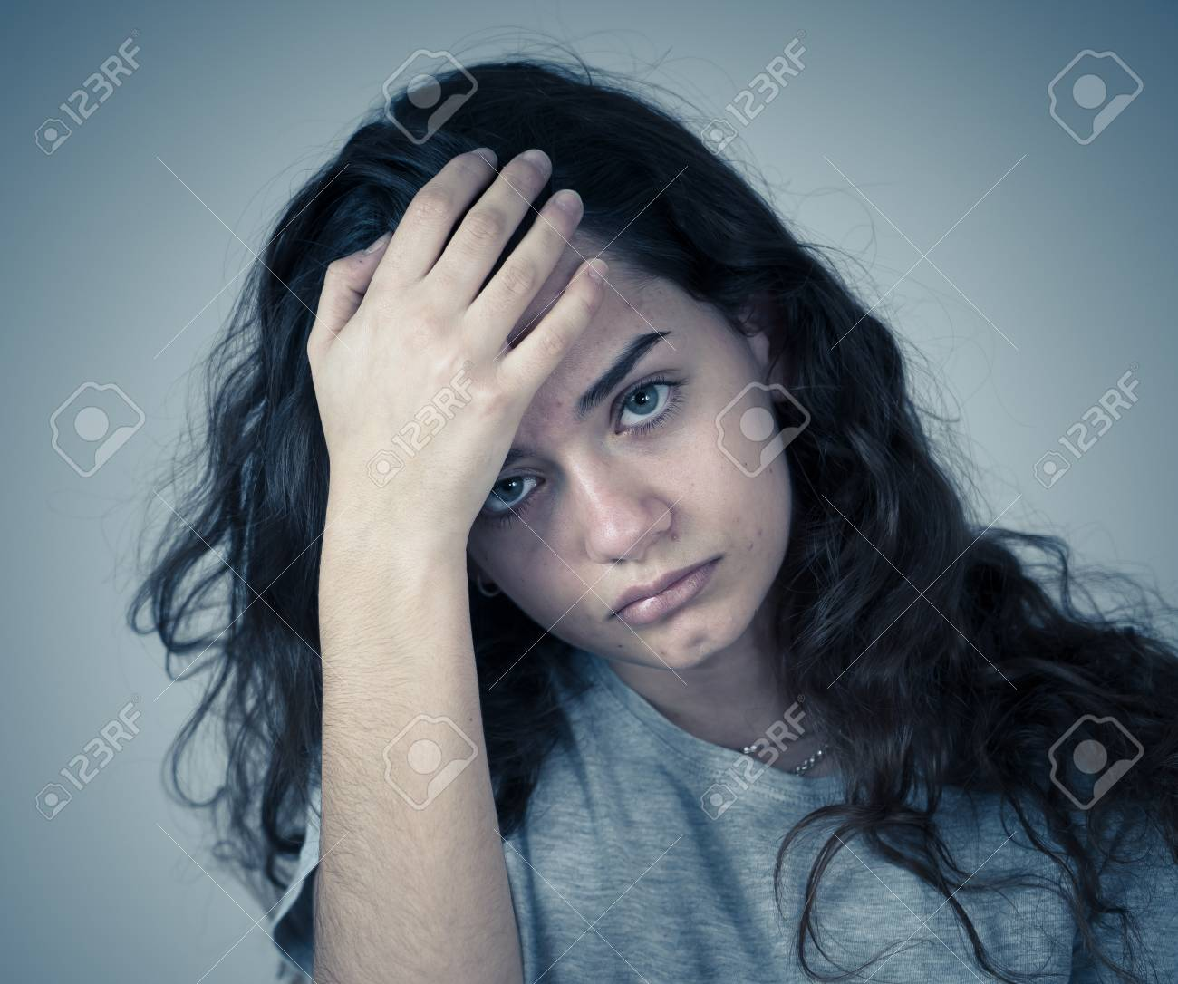
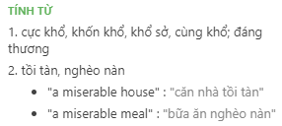
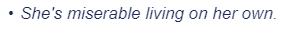
Vocabulary plus
Adjectives describing feelings
miserable
/ˈmɪzrəbl/
very unhappy or uncomfortable

Slide 12
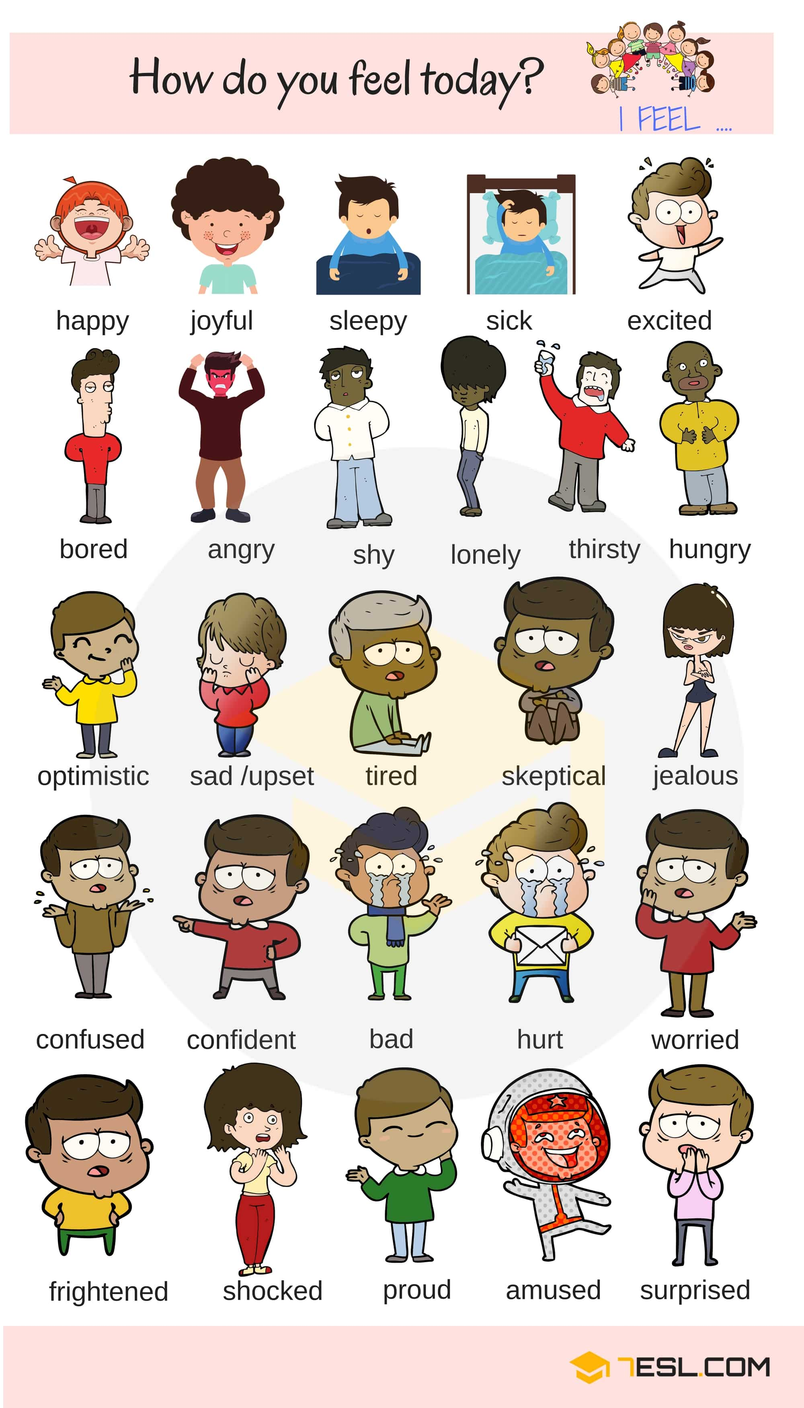
Adjectives
describing feelings

Slide 14
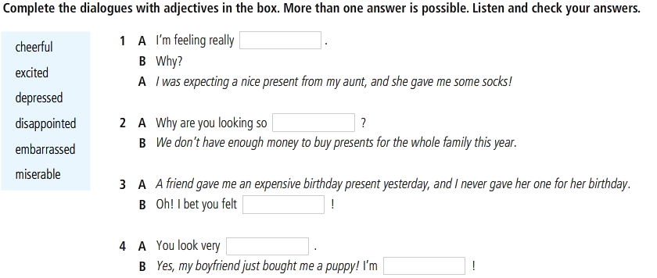

Vocabulary plus
Adjectives describing feelings

Slide 15
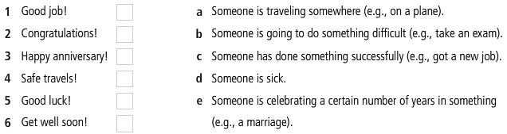
Vocabulary plus
Useful expressions
Match the expressions in A with the occasions in B.

Slide 16
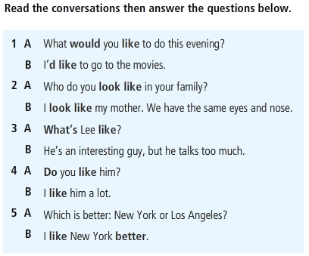
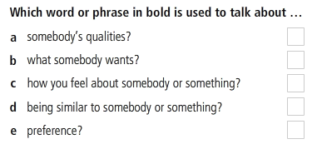
Vocabulary plus
Focus on: LIKE

Slide 17
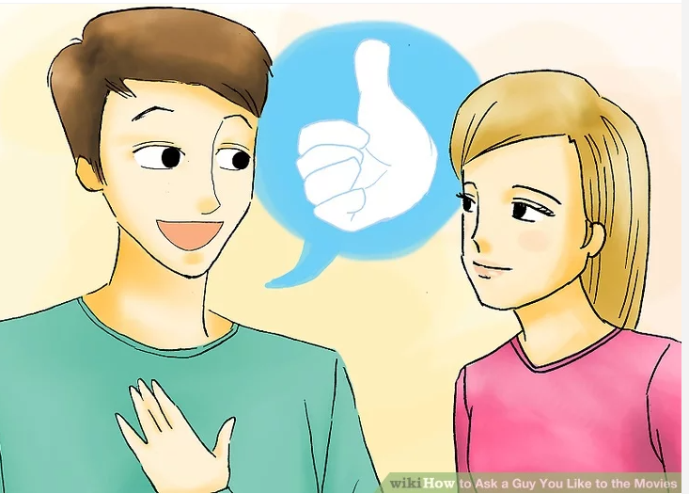
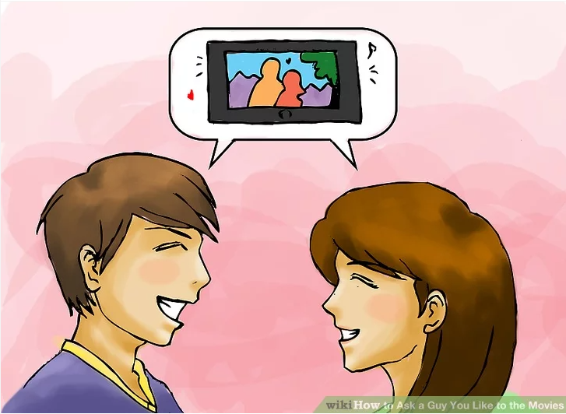
Language in action
Making invitations and suggestions

Slide 18
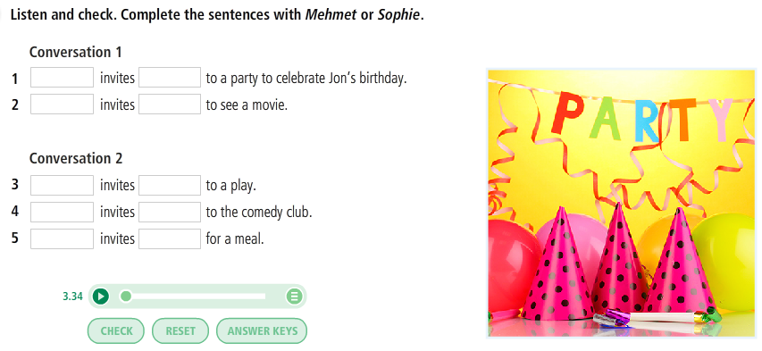
Listening

Slide 19
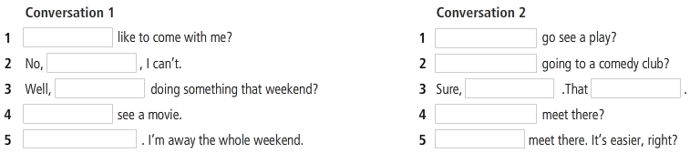
Language in action
Making invitations and suggestions

Slide 20
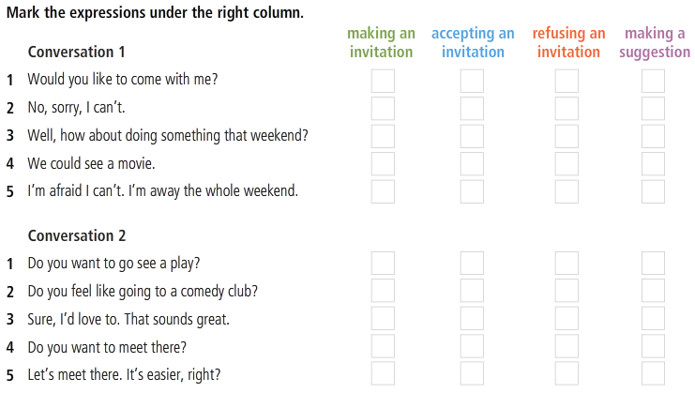
Making invitations and suggestions

Slide 21
Language in action
Making invitations and suggestions
Practice
Try making invitations in these practice scenarios:
Invite your boss over for dinner next week.
Invite an old friend out for a drink/meal.
Invite your grandmother to visit you in your new home.
Invite your brother or sister over to watch a movie.
Invite a work client to have lunch with you.

Slide 22
REFERENCES
Vocabulary: Adjectives describing feelings (quiz)
https://www.youtube.com/watch?v=7uY2HrQ9qQ8
Vocabulary: Adjectives describing feelings (quiz)
https://www.youtube.com/watch?v=uDs4M2xEN3g
Language in action: Making invitations and suggestions
https://www.youtube.com/watch?v=0bge21vAA4A
Listening and repeating after the video
https://www.youtube.com/watch?v=TbITdAq_IQQ
https://www.youtube.com/watch?v=-rk-57FCyb0

